Slide 1
Boreal Summer Intraseasonal Oscillation
Bin Wang
Department of Atmospheric Sciences,
University of Hawaii at Manoa
WMO ONLINE TRAINING WORKSHOP ON
SUBSEASONAL TO SEASONAL (S2S) PREDICTION OF MONSOONS
11-4-2021 03-05 UTC

Slide 2
I. Distinct features
2. Essential Dynamics
3. Monitoring and Predictability
4. Teleconnection and impacts
5. 30-60 day BSISO diversity
OUTLINE

Slide 3
BSISO Concept in retrospect
Discovery of N-ward propagation from EIO to India (Yasunari 1979, 1980), Sikka and Gadgil 1980)
Finding of W-ward propagating biweekly disturbances (Murakami 1980)
Recognition of pronounced seasonality of ISO in their intensity (Madden 1986), movement (Wang and Rui 1990), and periodicity (Hartmann et al. 1992).
A theoretical model for BSISO advanced (Wang and Xie, 1997)
The MJO and BSISO have distinct circulation structures, propagation patterns, and life cycles (Waliser et al. 2003).
Five distinguished features of BSISO summarized (Wang, Webster et al. 2006)
A Bimodal representation of ISO (Kikuchi et al. 2012).
A real time multivariate BSISO indices monitoring BSISO (J.-Y. Lee et al. 2013).
Assessment of BSISO predictability and prediction skill. (S.-S. Lee et al. 2015).
BSISO diversity (Chen and Wang 2021)

Slide 4
1. Distinct features of BSISO

Slide 5
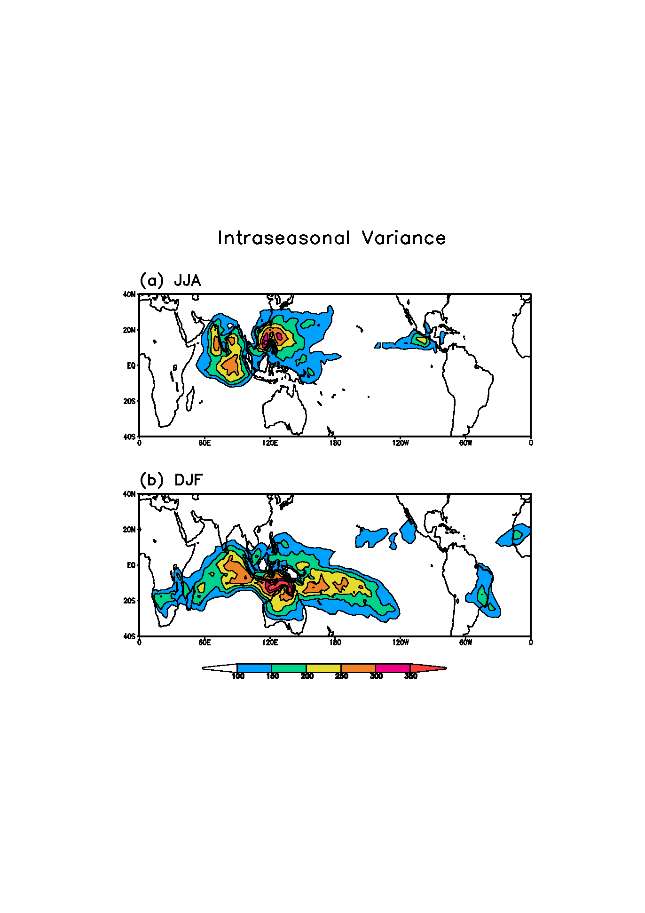
Pronounced seasonal migration of ISO convection variability
OLR
Tropical Monsoon tough
1979~2010
Eastern EIO is a permanent ISO convective variability center
SIO and SP convergence zone
1979~2009
(W/m²)²
1979-2010

Slide 6
Composite life cycle of ISO rain rate (contour) & SST (shading)
Blue: dry anomaly
Green wet anomaly
Warmer SST leads enhanced rain belt
Wang, Webster et al. 2006

Slide 7
Schematic evolution of tropical ISO rain anomalies
A four-stage evolution
1. ISO rainfall anomalies initiates in the EIO around 60-70E.
2. It reaches maximum intensity at Eastern EIO around 90E.
3. It bifurcates over Sumatra and poleward emanation, forming a SE-NW tilted rain belt from region of Sumatra-Borneo to eastern Arabian Sea.
4. The slanted rain band then moves northeastward. The equatorial WP anomalies rapidly traverse the ITCZ across the Pacific, meanwhile migrate northward slowly to Philippine Sea.
Wang, Webster et al. 2006

Slide 8
Bimodal nature of the tropical ISO
MJO leading mode
BSISO leading mode
Seasonal distribution
Phase 1
MJO
Phase 1
Phase 3
Phase 3
Average number of days per month
Phase 5
Phase 5
Phase 7
BSISO
Phase 7
month
Kikuchi, et al., 2011

Slide 9
Summary: Distinctive features of BSISO
Prominent northward propagation prevails in the northern IO, and WNP (Yasunari 1979; Krishnamurti and Subrahmanyam 1982; Chen and Murakami 1988, Jiang and Waliser 2009).
Major centers of variability in precipitation shift to Asian-Pacific and North American summer monsoon (10-20°N) (Kemball-Cook and Wang 2001).
The leading mode shows a NW-SE tilted precipitation band propagating NE-ward (Ferranti et al. 1997; Wang and Xie 1997).
A significant stationary component- a convective seesaw between the equatorial IO and the WNP (Lau and Chan 1986, Zhu and Wang 1993).
Double periodicities: 30-60 days and 10-20 days (e.g., Kikuchi and Wang 2010). Biweekly mode propagates westward in monsoon regions.

Slide 10
2. Essential dynamics of BSISO

Slide 11

Essential Physical Processes involved in BSISO
Boreal Summer
ISO
Essential Large scale
MJO dynamics
Low-Frequency
Equatorial Waves
Background Circulation
(Annual & Interannual )
Moisture feedback
Convective
Latent
Heating
Boundary
Layer
Dynamics
Moisture
Distribution

Slide 12
Theoretical Framework for ISO
(nondimensional)
Long wave
approximation
Mean flow
effects
Boundary layer Ekman Pumping: (Wang and Rui 1990)
Wang and Xie: A model for boreal summer ISO, JAS 1997

Slide 13
Mean Flow Terms

Slide 14
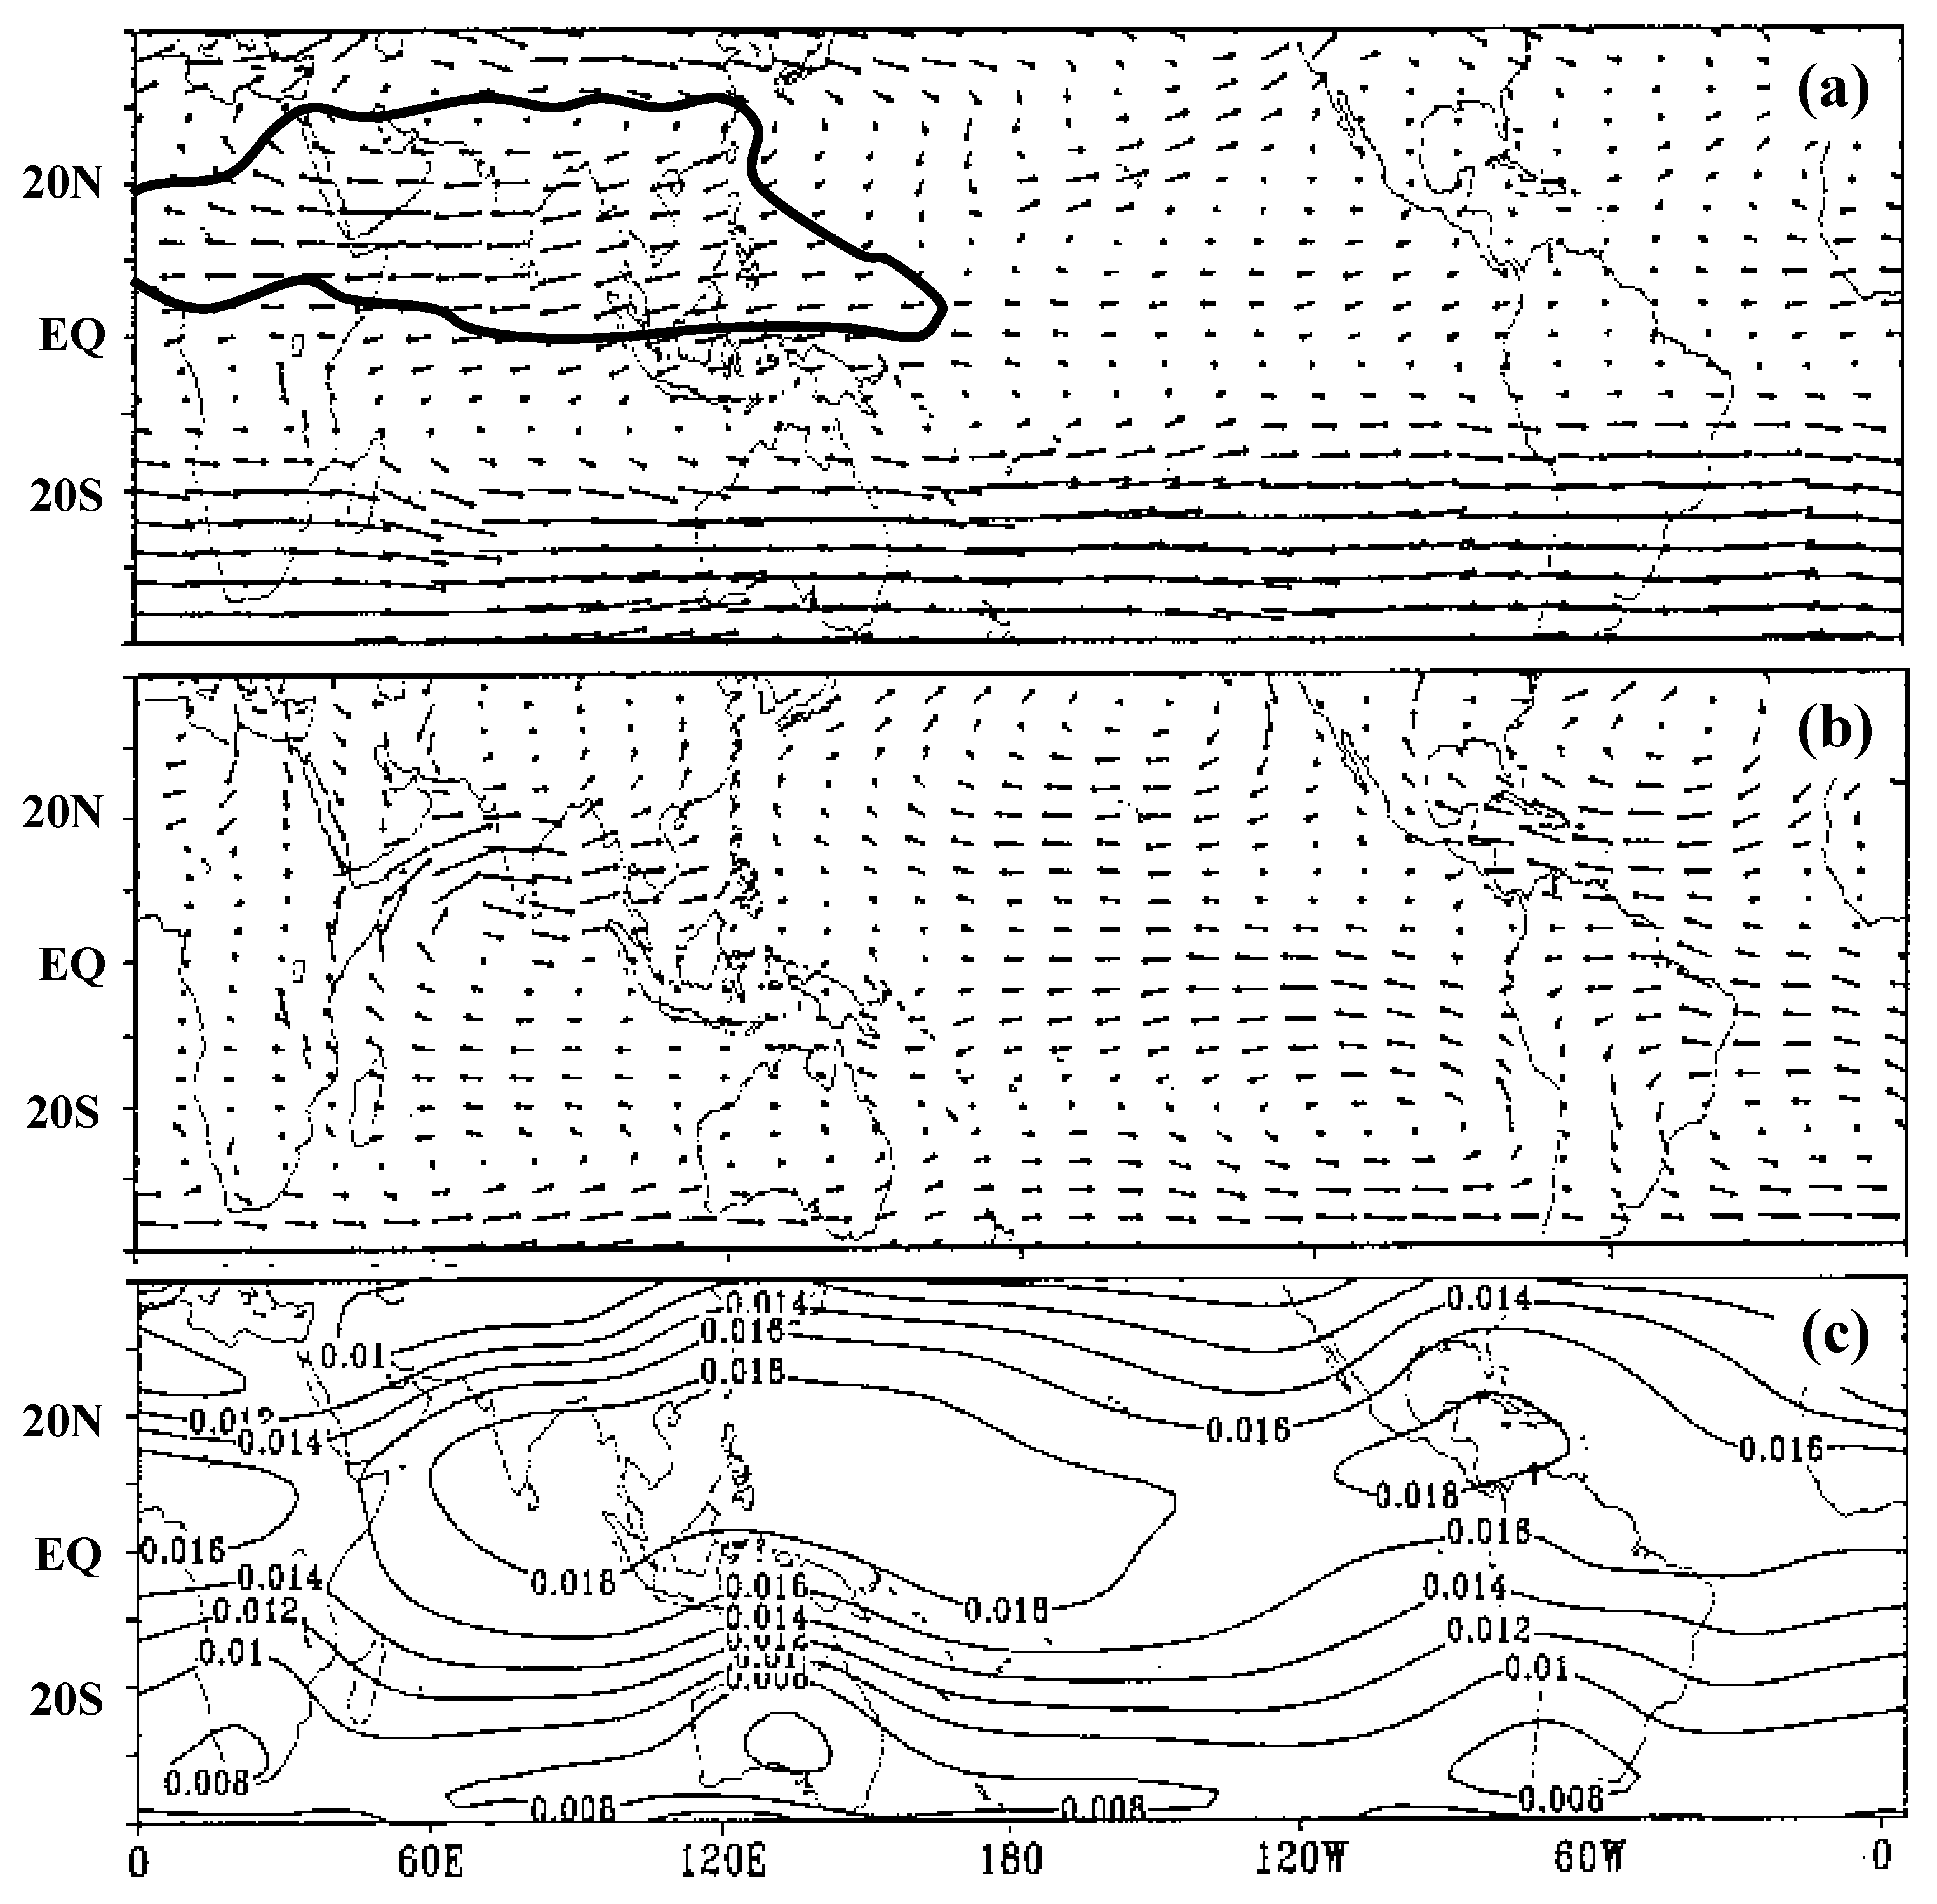
Model basic state: July mean state (ER40)
Easterly shear
200 hPa winds
850 hPa winds
Surface specific humidity
Maximum shifted to 10ºN

Slide 15
Propagation of BSISO Rainfall Anomaly
Formation of NW-SE slanted precipitation band
The Rossby wave (RW) is trapped in NH and has a northward propagation component

Slide 16
Explanation of BSISO
Why does the BSISO variability center shifted to monsoon regions?
Why does the summer monsoon ISO have a NW-SE slanted structure? How does the tilted rain band form?
What give rise to the northward propagation of ISO over the summer monsoon regions?
How do the active/break cycles of ISM are re-initiated or maintained?

Slide 17
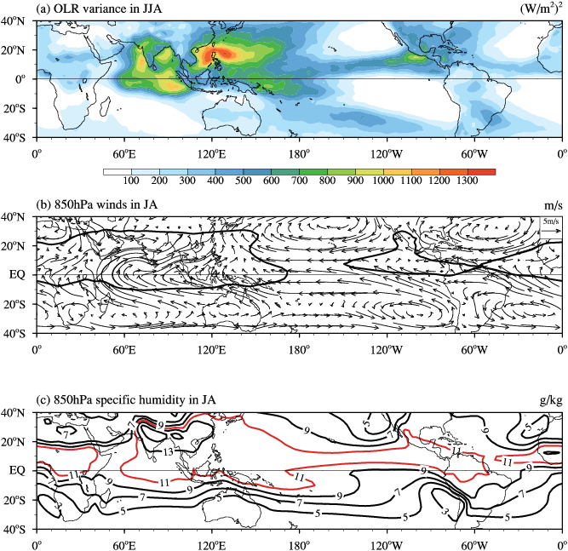
Why does BSISO variability center shift to monsoon region?
The ISV activity is trapped by boreal summer MSE (or SST) distribution and monsoonal vertical wind shears.

Slide 18
How does the NW-SE tilted rain band form?
In the model, the NW-SE slanted precipitation anomalies in the monsoon regions forms
due to emanation of the moist Rossby waves from the equatorial rainfall anomalies over the maritime continent.
Drbohlav and Wang 2005

Slide 19

How easterly vertical shear pulls the RW Northward
z
Generation of Barotropic Vorticity
Wang and Xie 1996
CONV
CONV
PBL
y (North)
x (East)
An atmospheric internal dynamic mechanism for northward propagation: monsoon easterly vertical shear provides a vorticity source, which, upon being twisted by the north-south varying vertical motion field associated with the Rossby waves, generates positive vorticity north of the convection, creating boundary layer moisture convergence that favor northward movement of the enhanced rainfall.

Slide 20
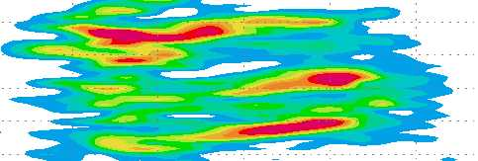
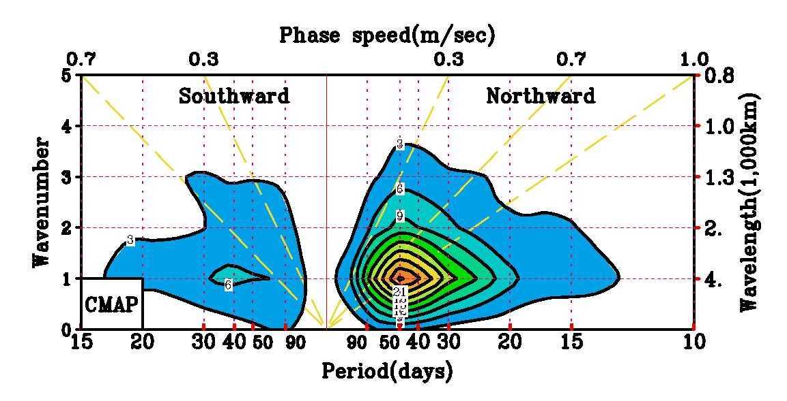
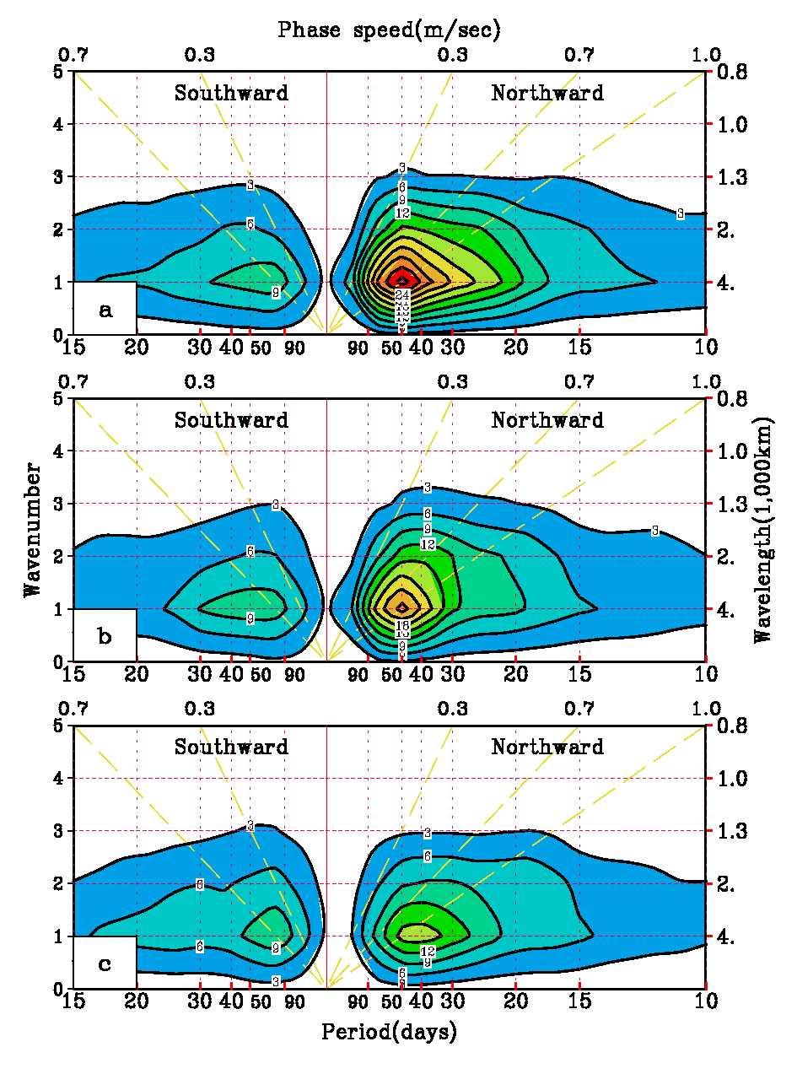
Roles of air-sea coupling in northward propagation
CMAP Rainfall
Coupled
Daily Forced
Mean Forced
(Fu and Wang 2004)

Slide 21
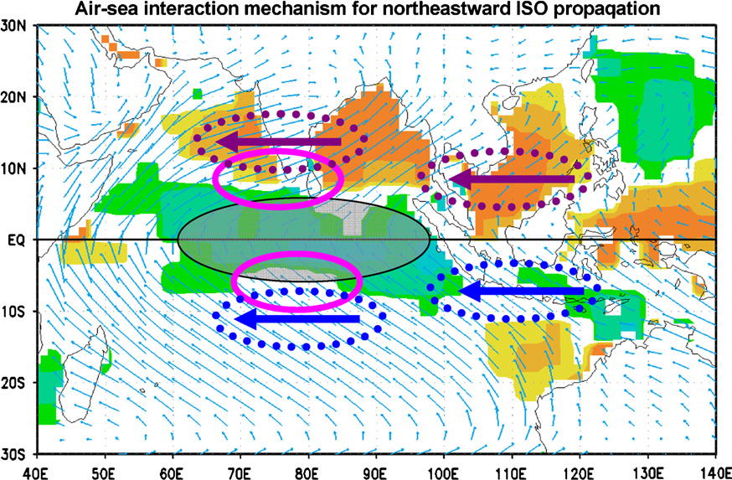
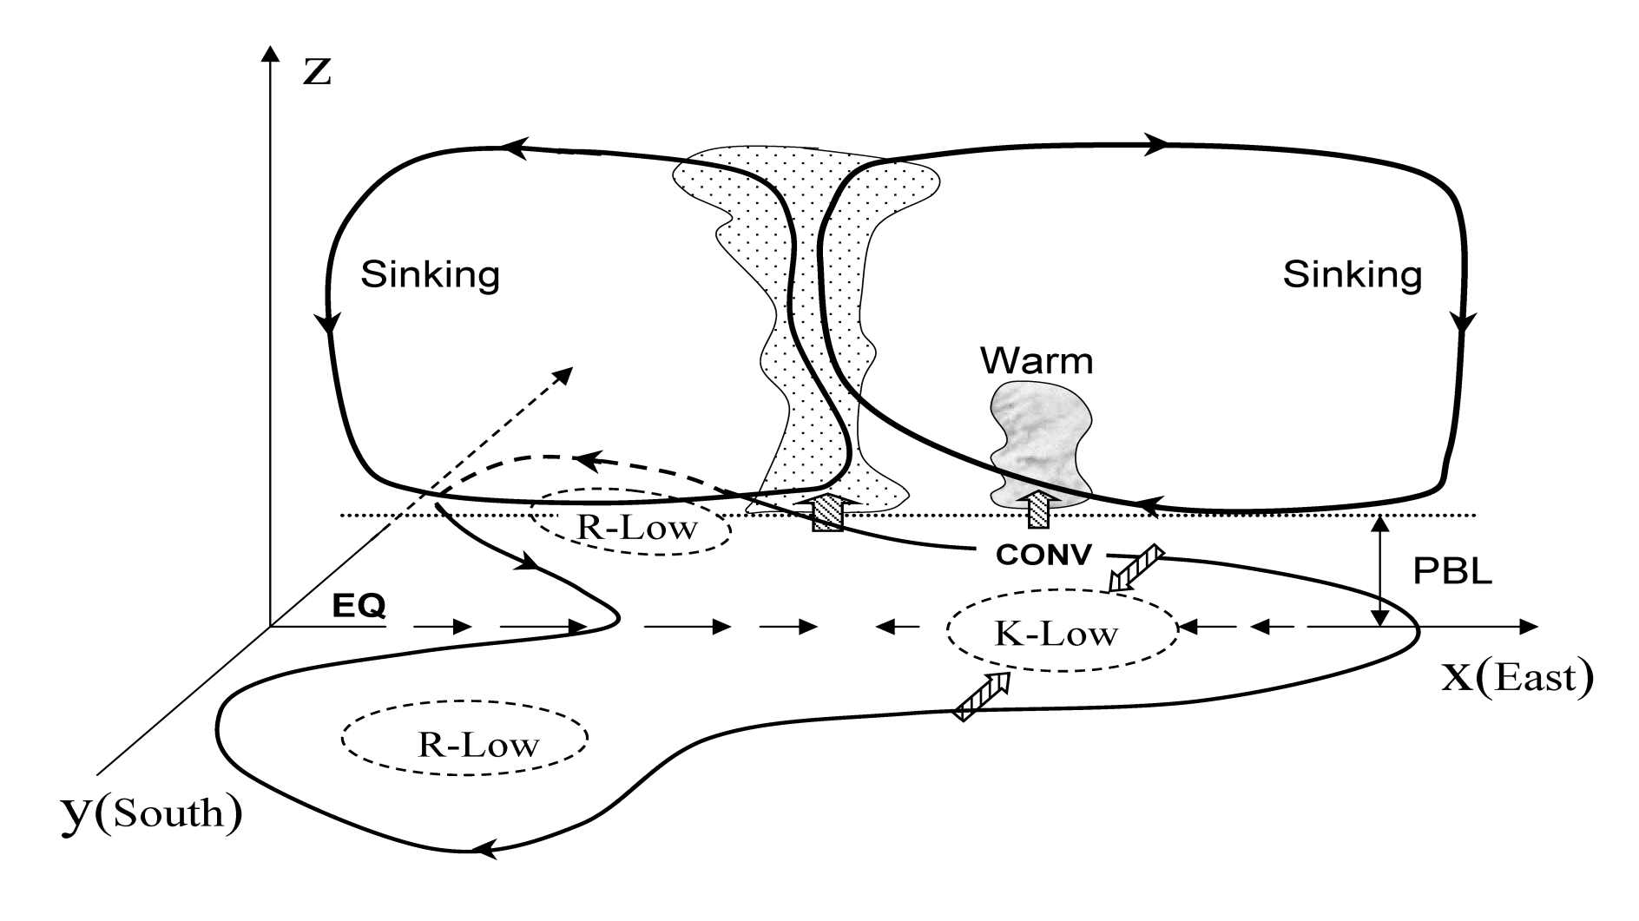
How A-O Interaction drives BSISO NE-ward?
RW Low
ISV convection
K-Wave
RW Low
Upward Surface latent heat flux
Downward Solar radiation flux
Shallower NH mixed layer vs. deeper SH ML
Wang et al. (2009)

Slide 22
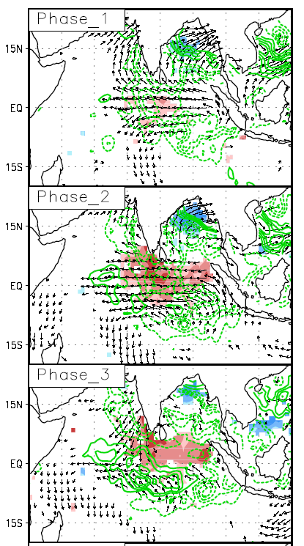
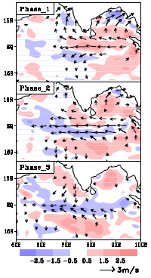
How is ISO convective anomaly initiated in EIO?
Rainfall (contours) and SST (color)
Surface winds and divergence
Indian monsoon peak wet, the eastern EIO is in a peak dry.
The eastern IO peak dry generates easterly anomalies that converge in the western-central IO, initiate convection.
The eastern IO dry also induces warmer SST to the east of the initial convection anomaly.
The initial rainfall anomalies result from the forcing of the previous active monsoon, suggesting a self-Induction mechanism to sustain BSISO.
Wang, Webster, Teng 2005

Slide 23
Summary
BSISO is a modified MJO mode by boreal summer mean flows.
The BSISO variability pattern is controlled by trapping effects of combined Easterly Vertical Shear and Moist Static Stability.
The convective band forms due to emanation of the moist Rossby waves as equatorial K-R Couplet weakens.
Easterly Vertical wind shear and positive ISO-SST feedback plays key roles in formation of the BSISO rain band and northward propagation of the BSISO.
BSISO convection anomaly initiates in the western EIO due to previous eastern EIO dry anomaly–induced western EIO surface wind convergence and sea surface warming. It suggests a self-Induction mechanism sustaining BSISO.

Slide 24
3. BSISO Monitoring and predictability

Slide 25
Advantages of RMM index
1. Avoid the typical Filtering problem in real-time use
2. Convenient for application (monitoring and prediction): Reduction of parameters
3. Represent the MJO in individual phase
Composite: OLR & U850
P-1
P-2
P-3
P-4
P-5
P-6
P-7
P-8
Phase diagram (RMM1, RMM2)
: Nov1979-Apr1980
WNP
P7
P6
WH
P8
P5
MC
Afr
P1
P4
P2
P3
Indian Ocean

Slide 26
Limitation of RMM index in representing BSISO
Fig. 1 (a) Variance of pentad mean OLR anomaly (W² m⁻⁴) after removing climatological annual cycle and interannual variability during November to April (NDJFMA) and May to October (MJJASO), respectively. (b) Fractional variance (%) of 5-day mean OLR anomaly accounted by the two-component RMM index. Blue dashed line in right-hand side of (a) indicates the Asian summer monsoon (ASM) domain. Red contour in (b) represents OLR variability center with variance larger than 800 W² m⁻⁴ shown in (a).

Slide 27
First two Leading modes of BSISO
Lee et al. 2013

Slide 28
BSISO 1 evolution
Monitoring BSISO1 in phase plane

Slide 29
BSISO 1 and BSISO 2 represent, respectively 30-60day and 10-30 day BSISO
30-60-day BSISO 1
10-30-day BSISO 2
SW-NE tilted precipitation belt moving NW-ward

Slide 30
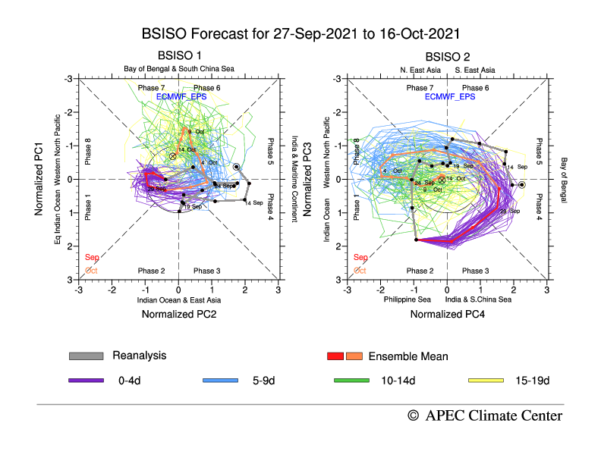
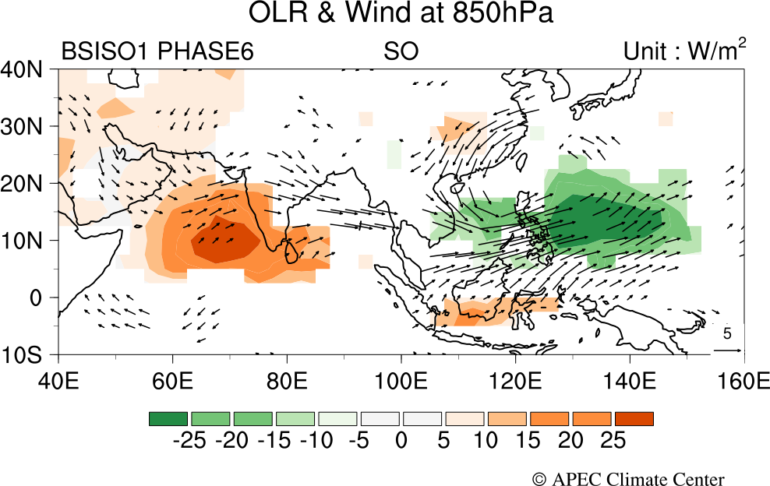
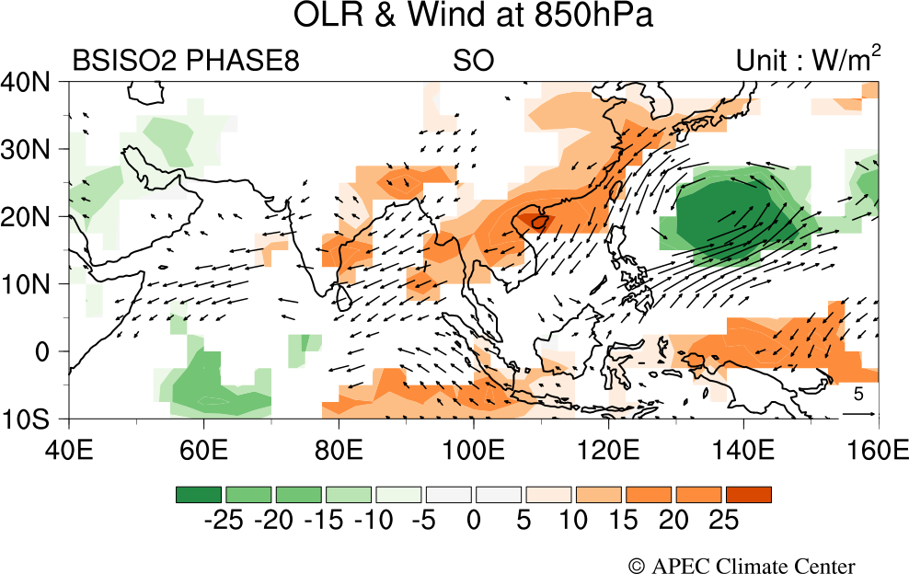
BSISO forecast: 27-Sep 2021 to 16-Oct 2021

Slide 31
BSISO 1 explains more ISO variance than RMM1
Fractional variance of pentad OLR and U850 anomalies
20%
50%
Lee et al. (2013)
However, due to regional differences between the Indian Ocean (IO) and Western Pacific (WP), a uniform BSISO index remains deficient to capture the total variance over the ASM region.

Slide 32
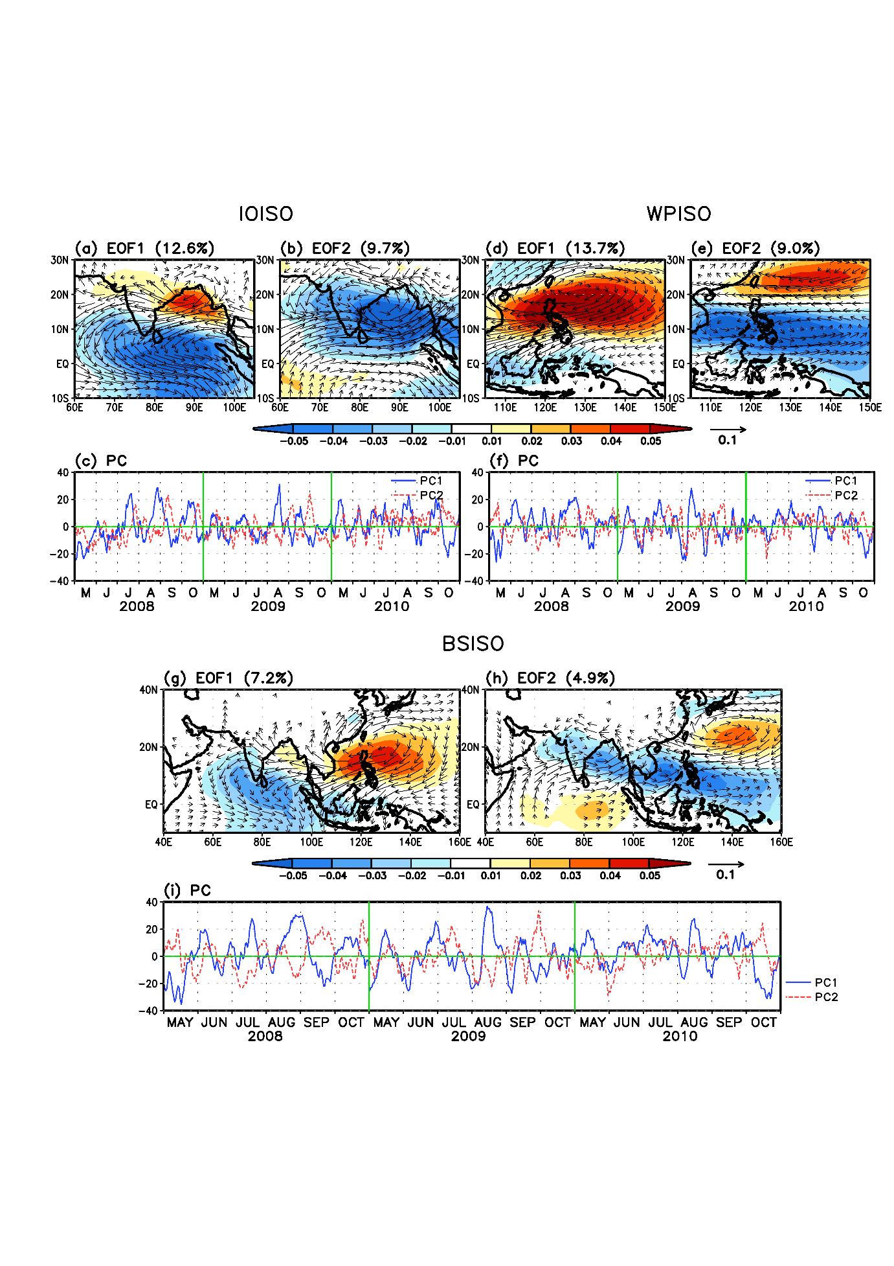
Regional BSISO: IO and WNP
CC (IOISO PC1, WPISO PC1)=0.41 at 0-day lag
→ Out-of-phase pulse of convection between the IO and WP
Principal modes of IOISO and WPISO
S.-S. Lee and Wang 2016

Slide 33
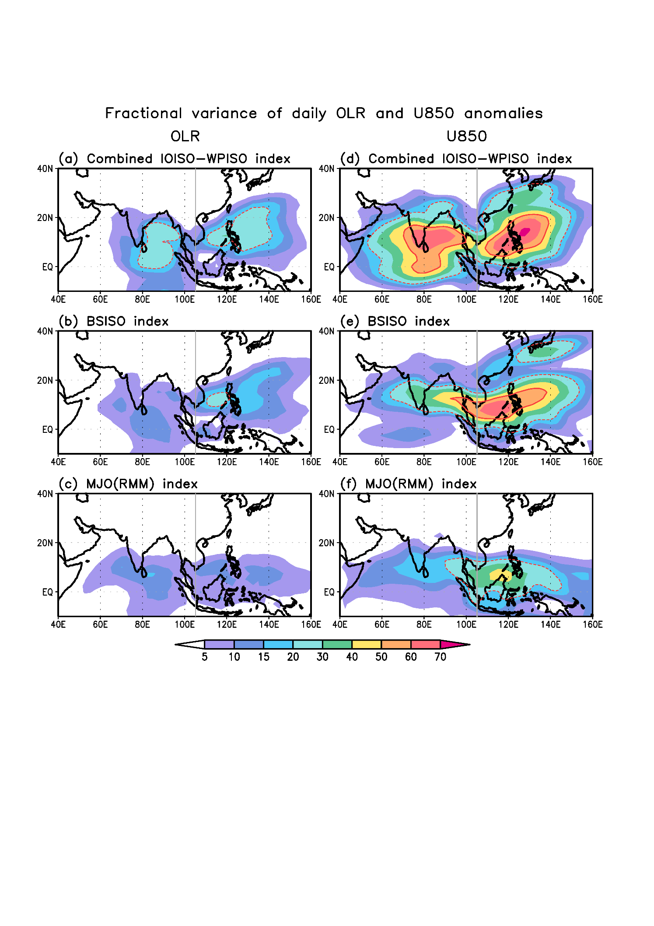
Regional BSISO captures more Fractional variance
Combined IOISO-WPISO index: IOISO PC1/2 and WPISO PC1/2
BSISO index: PC1/2
MJO (RMM) index: RMM1/2
20%
50%

Slide 34
Monitoring Summary
The BSISO 1/2 indices capture more ISO variance than the RMM1/2 indices. The BSISO1 and 2 represent 30-60 day and 10-30 day ISO, respectively.
The IOISO features a NE propagation with a 30-45 day energy peak and the PC1 has maximum variance in May, while the WPISO propagates northward with a broad spectral peak on 10-60 days and the PC1 has maximum variance in August.
The combined IOISO-WPISO index captures about 30% (10%) of daily U850 (OLR) variance over the entire IO-WP region (10S-30N, 60-150E), which doubles that by the MJO index and is 50% higher than that by the BSISO index.

Slide 35
BSISO Prediction and Predictability
Lee, S.-S., B. Wang, D. E. Waliser, J. M. Neena, J.-Y. Lee, 2015: Predictability and prediction skill of the boreal summer intraseasonal oscillation in the Intraseasonal Variability Hindcast Experiment. Climate Dyn., 45(7-8), 2123-2135, doi: 10.1007/s00382-014-2461-5.
Lee, S.-S. , B. Wang, 2016: Regional boreal summer intraseasonal oscillation over Indian Ocean and Western Pacific: Comparison and predictability study. Climate Dyn., 46(7-8), 2213-2229, doi: 10.1007/s00382-015-2698-7.

Slide 36
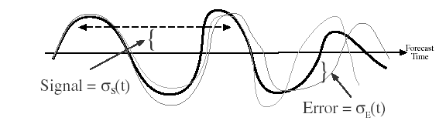

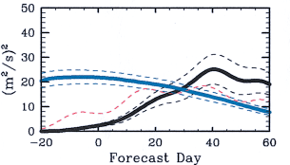


Signal to Error ratio estimate of MJO/ISV predictability
Control run
Perturbed Forecasts
Initial Condition
Differences Based On
Forecasts 1 Day Apart
Signal (L=25 days)
Mean square Error
Signal
Error
As in
Waliser et al. (2003, 2004);
Liess et al. (2005); Fu et al. (2007)
Except using a modern indices
(e.g. RMM1 & RMM2 for MJO)
Bivariate estimates of Signal and Error

Slide 37
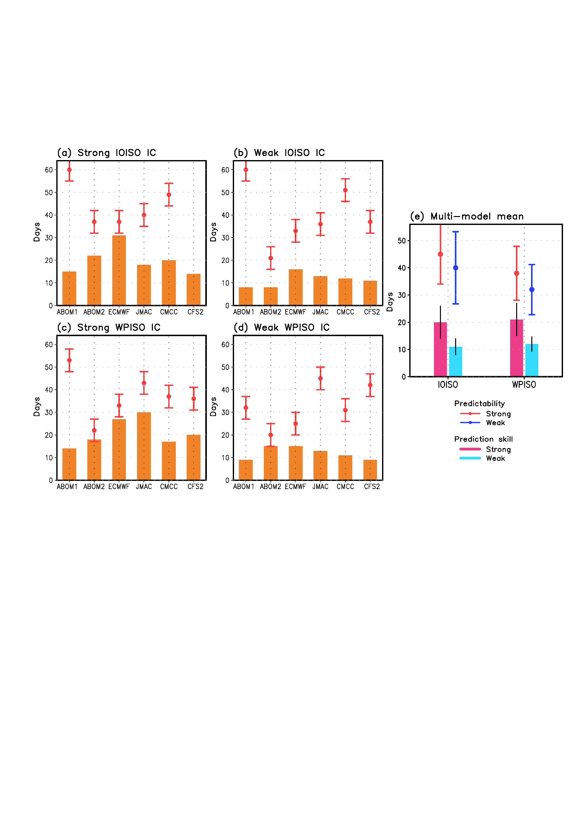
Predictability and prediction skill of IOISO & WPISO
* Strong IOISO/WPISO initial condition:
sqrt(OBS PC1² + OBS PC²) at forecast lead day 0 > 1.5
* Weak IOISO/WPISO initial condition:
sqrt(OBS PC1² + OBS PC²) at forecast lead day 0 < 0.8
Multi-model mean
Predictability | Strong | Weak
IOISO | 45 days | 40 days
WPISO | 37 days | 33 days
Predictability and prediction skill by ensemble-mean method
Prediction skill | Strong | Weak
IOISO | 20 days | 11 days
WPISO | 21 days | 12 days

Slide 38
Prediction/predictability Summary
The multi-model mean estimate of the predictability is 40-45 days for the IOISO index, whereas 33-37 days for the WPISO index, depending on the initial amplitude.
The multi-model mean prediction skill is significantly higher with large initial amplitude (~20 days for two indices) than that with small initial amplitude (~11 days).
Estimated predictability depends on the quality of the models used.

Slide 39
4. Impacts of BSISO on extreme whether and midlatitude

Slide 40
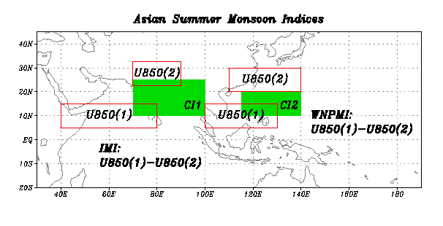
Asian summer monsoon ISO:
Monitoring BSISO Using monsoon circulation indices
Wang, Wu, Lau 2001, JC

Slide 41
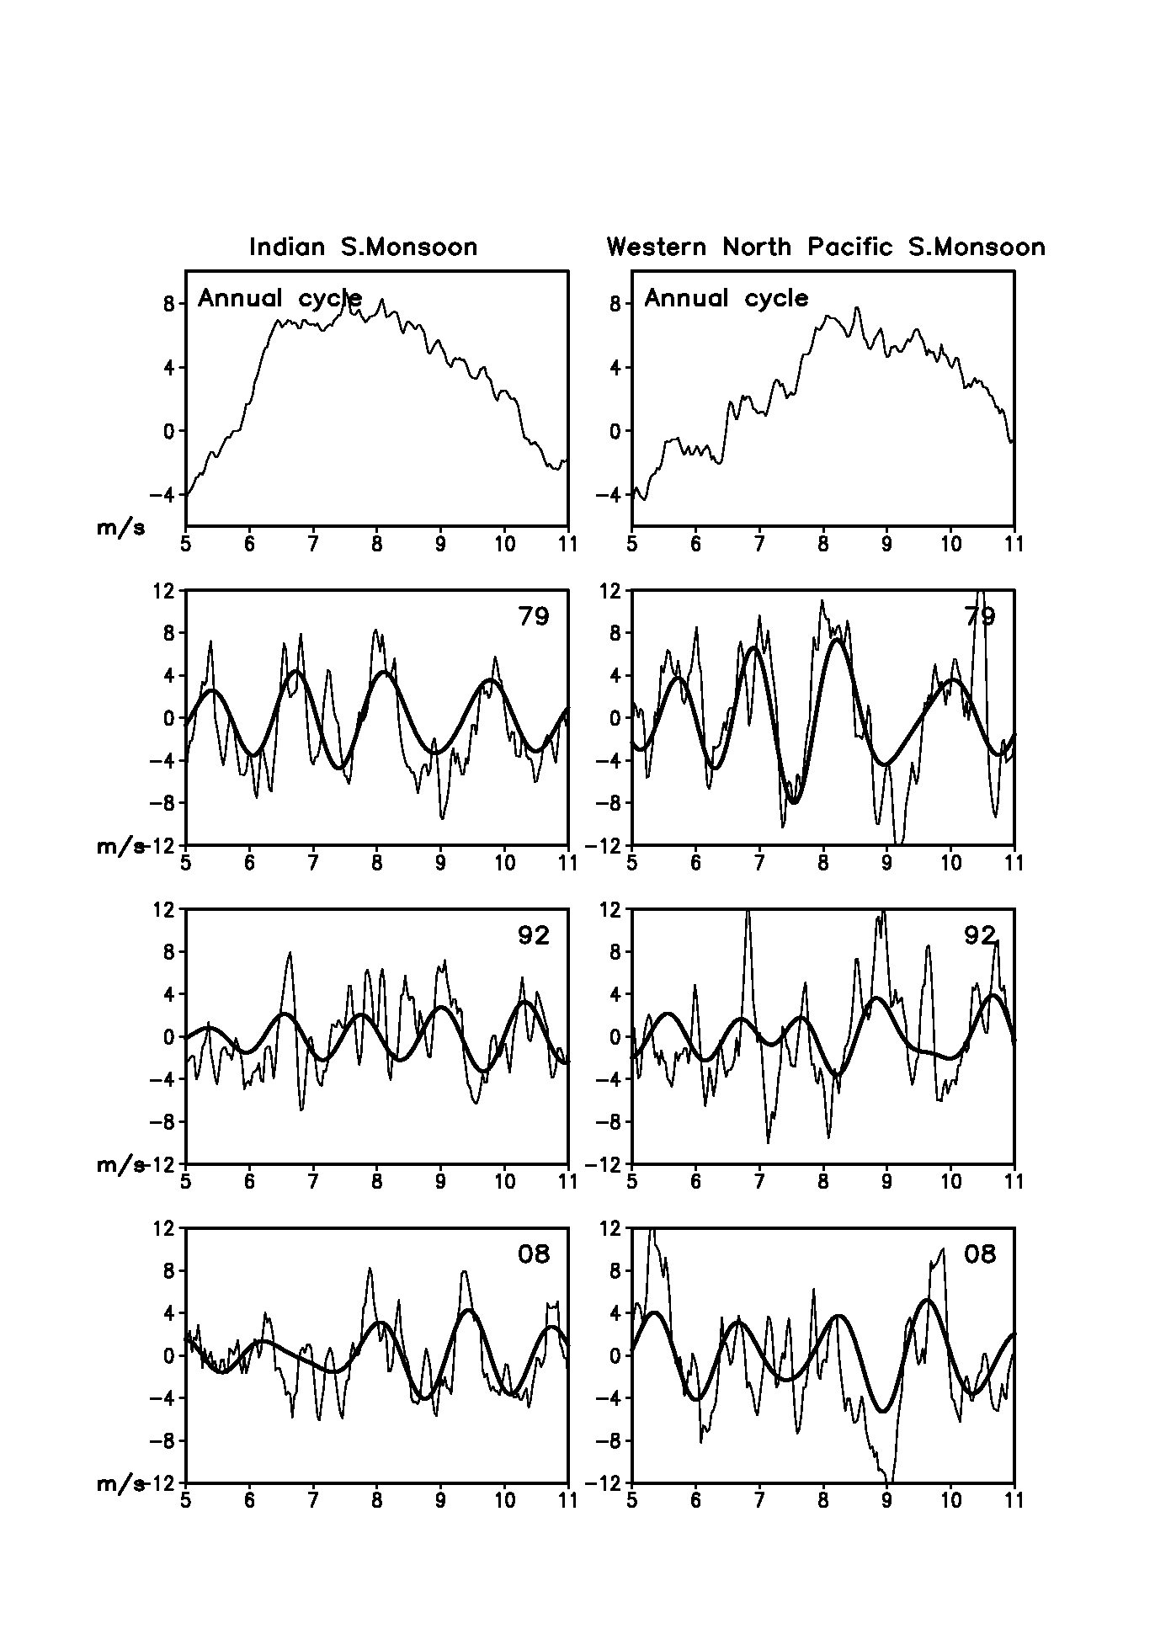
ISO of Monsoon circulation
ISM
EA-WPSM
1979
1992
2008
Time series of Indian Summer Monsoon Index (left)Western North Pacific Summer Monsoon Index (right).(top) Mean 365-day annual cycle (lower three panels) The thin lines are daily anomaly values, the thick lines are 30-60 day band-passed values for the years 1979, 1992 and 2008.

Slide 42
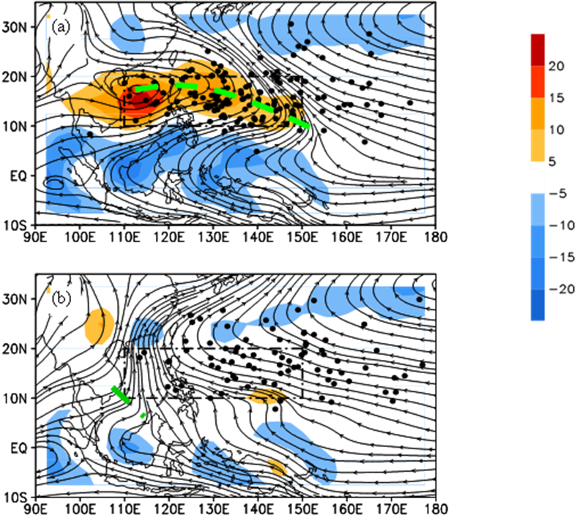
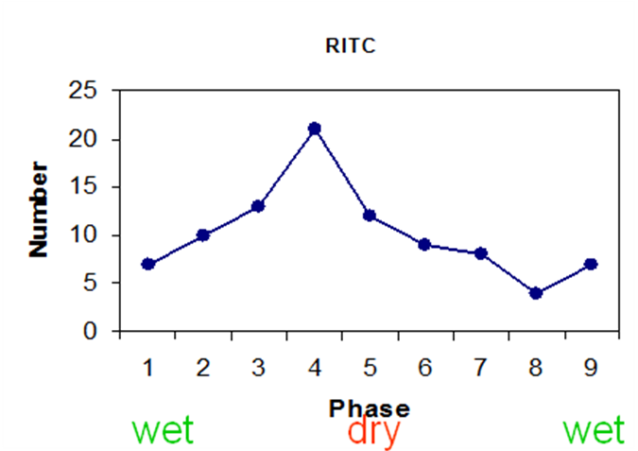
MJO Impacts – WNP TC
Composite for 55 ISO events
Phase 4 active WNP monsoon
The dashed box (10-20 ºN, 110-150 ºE): WNPSM trough
Phase 8 dry phase of WNP monsoon
Prediction value:
The RI maximum over the WNP lags the peak wet phase of the EWP ISO by three phases (about 12 days).
The minimum RI occurrence over the WNP lags the peak wet phase of the WNP ISO by seven phases (about 28 days).
Number of TC RI in the monsoon trough
Phases 1 (5) represents the strongest (weakest) convection phases over EWP (5ºS-5ºN, 140ºE-160ºE).
(c)
Wang and Zhou 2008

Slide 43
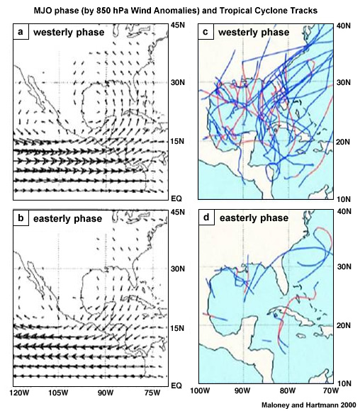
MJO Impacts – N Atlantic TC
The MJO often leads to “bursts” and “lulls” in tropical cyclone activity when active
Periods generally last for about two weeks
Due to changes in both lower and upper-level winds and convection

Slide 44
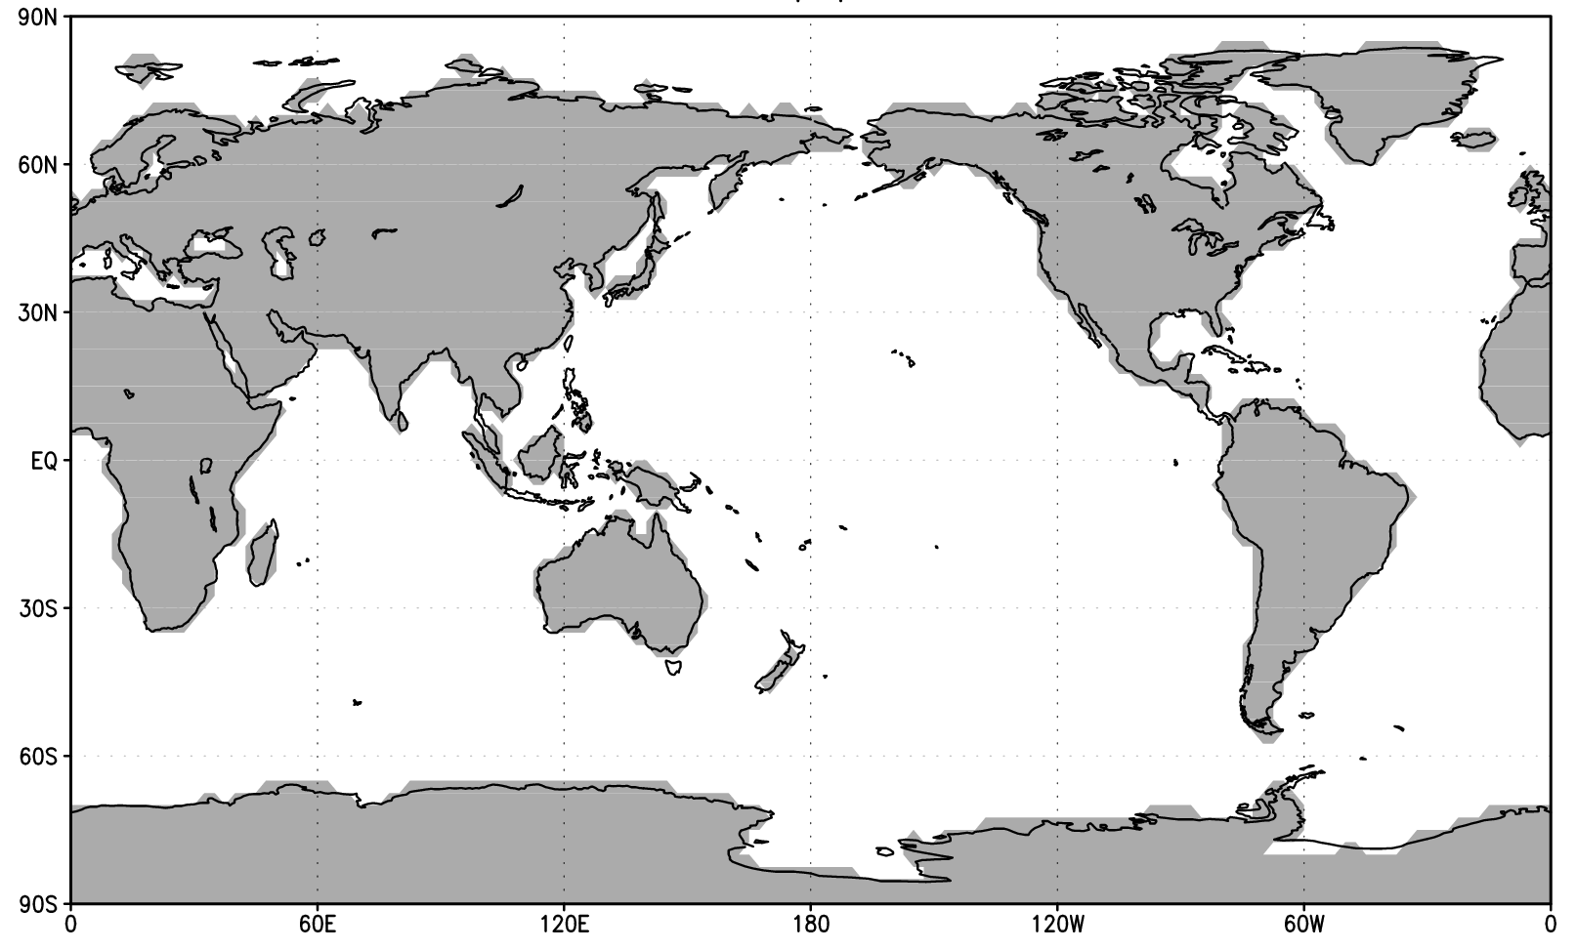

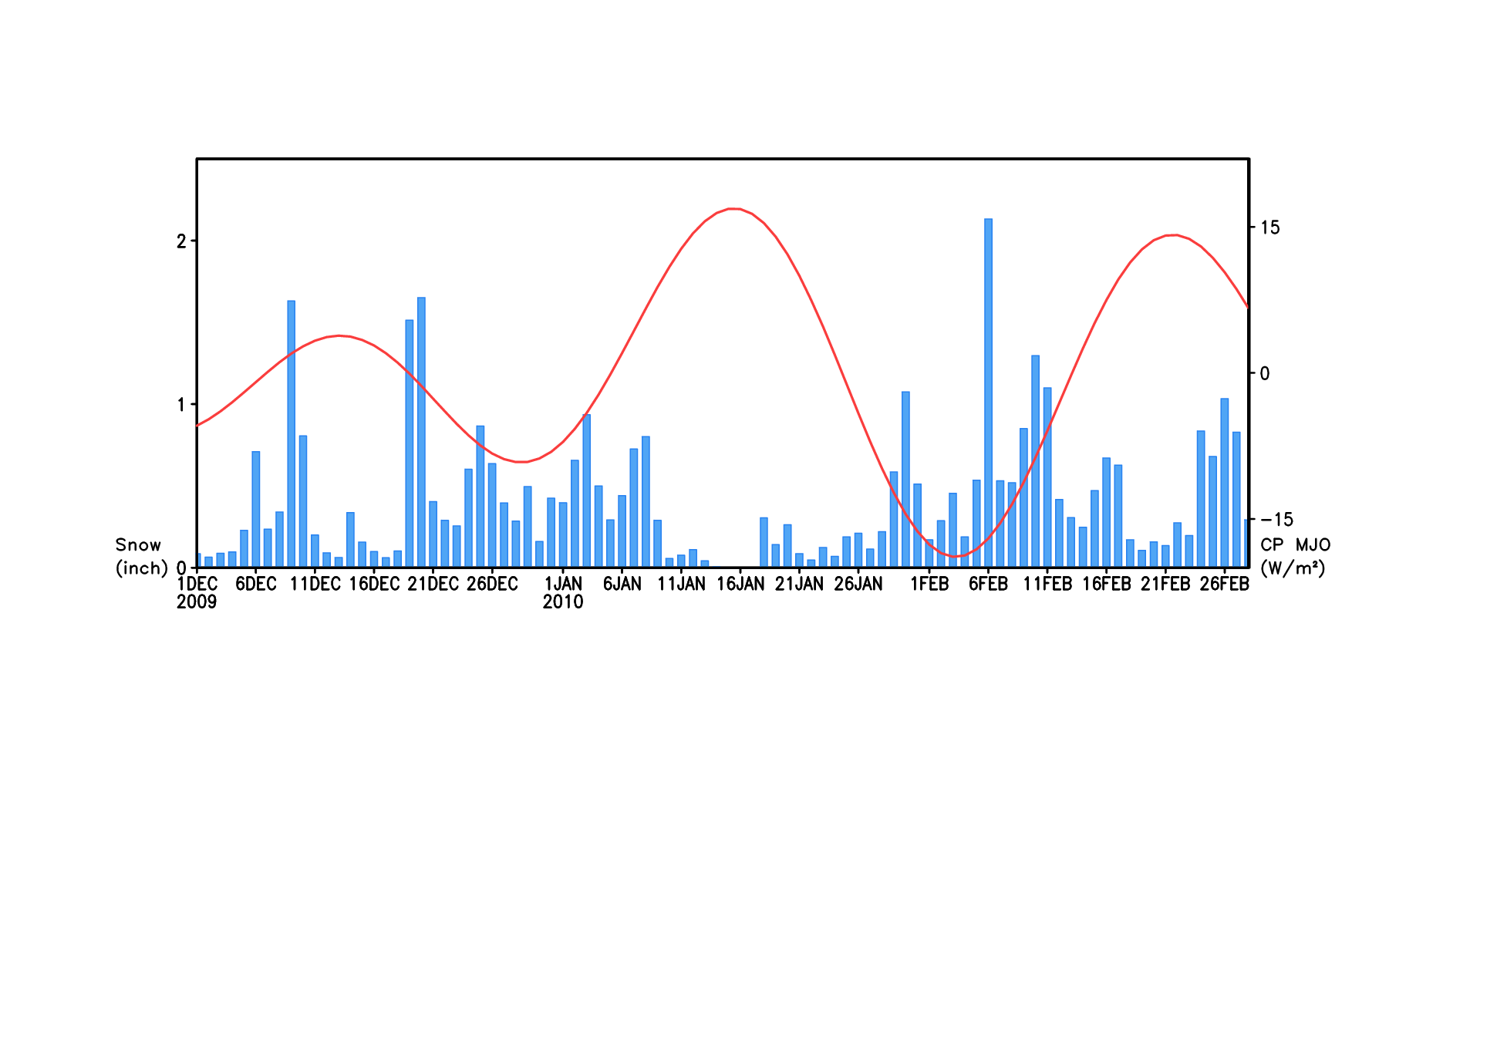
MJO and the Record-Breaking USEast Coast Snowstorms in 2009/10
L
H
L
L
L
H
H
H
Bar: Eastern US snow
Line: Central Pacific MJO
Moon et al. 2012

Slide 45
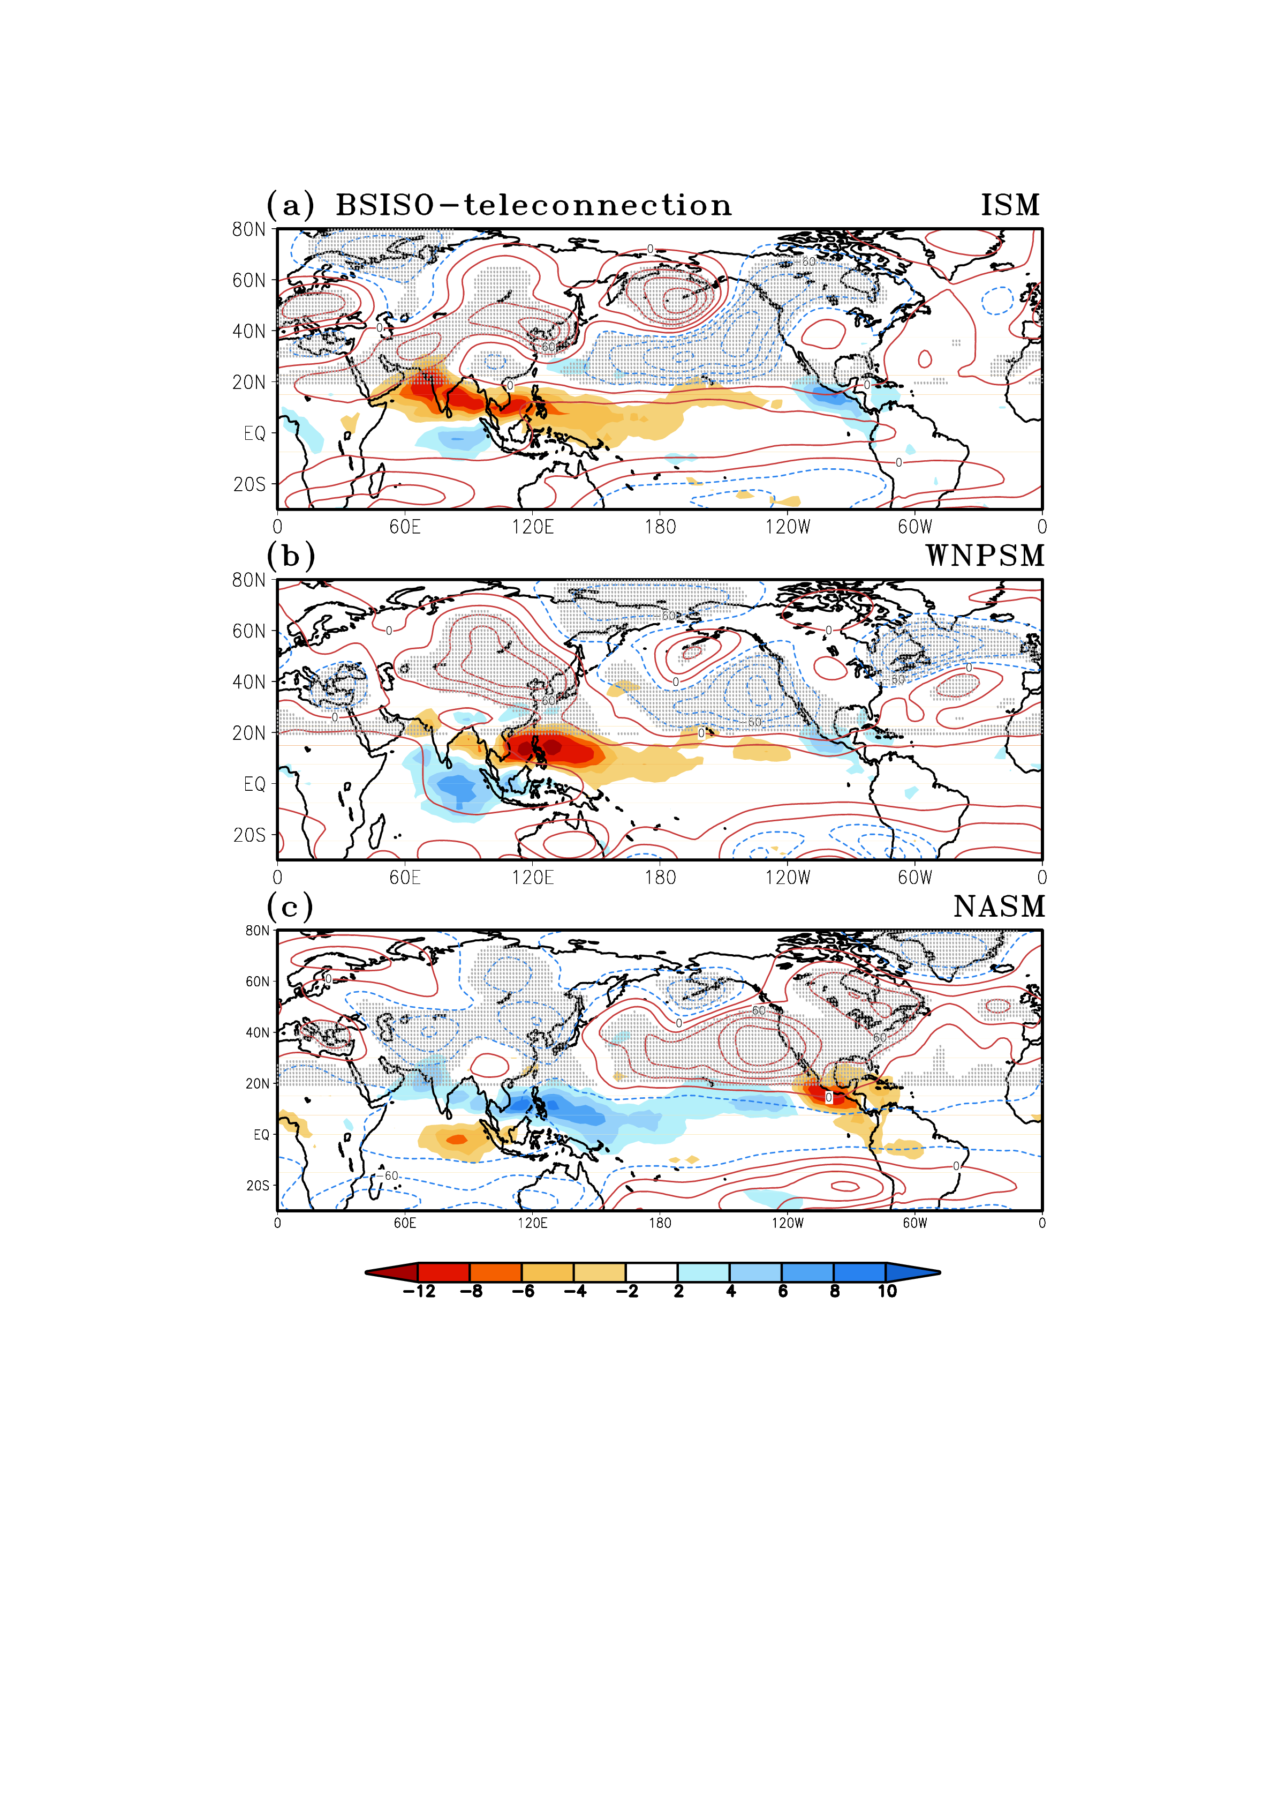
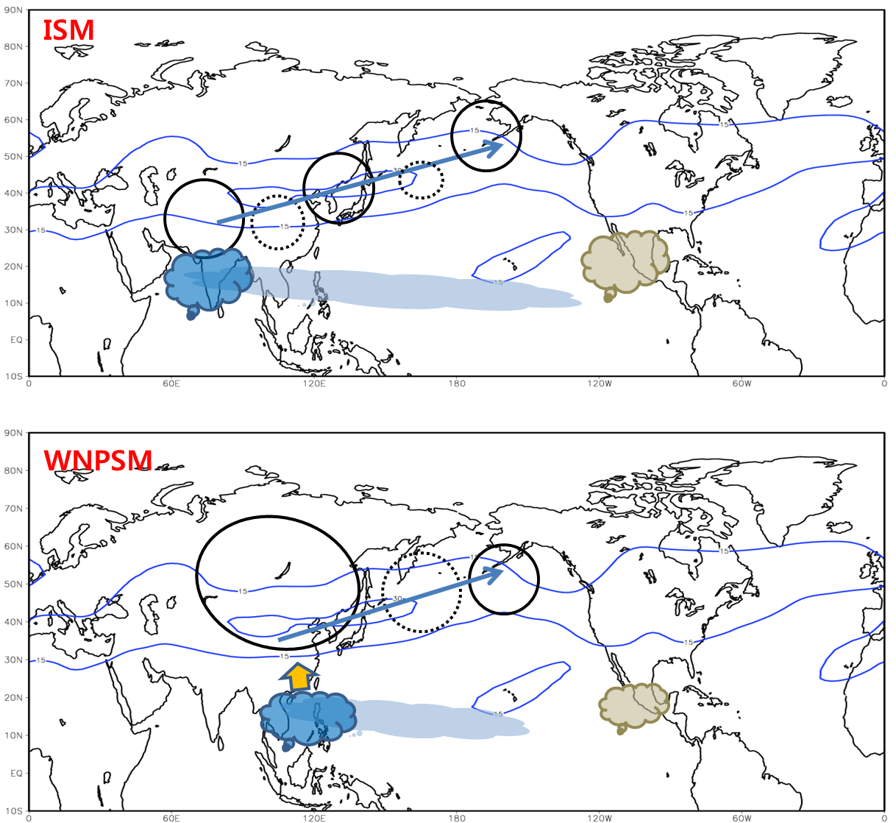
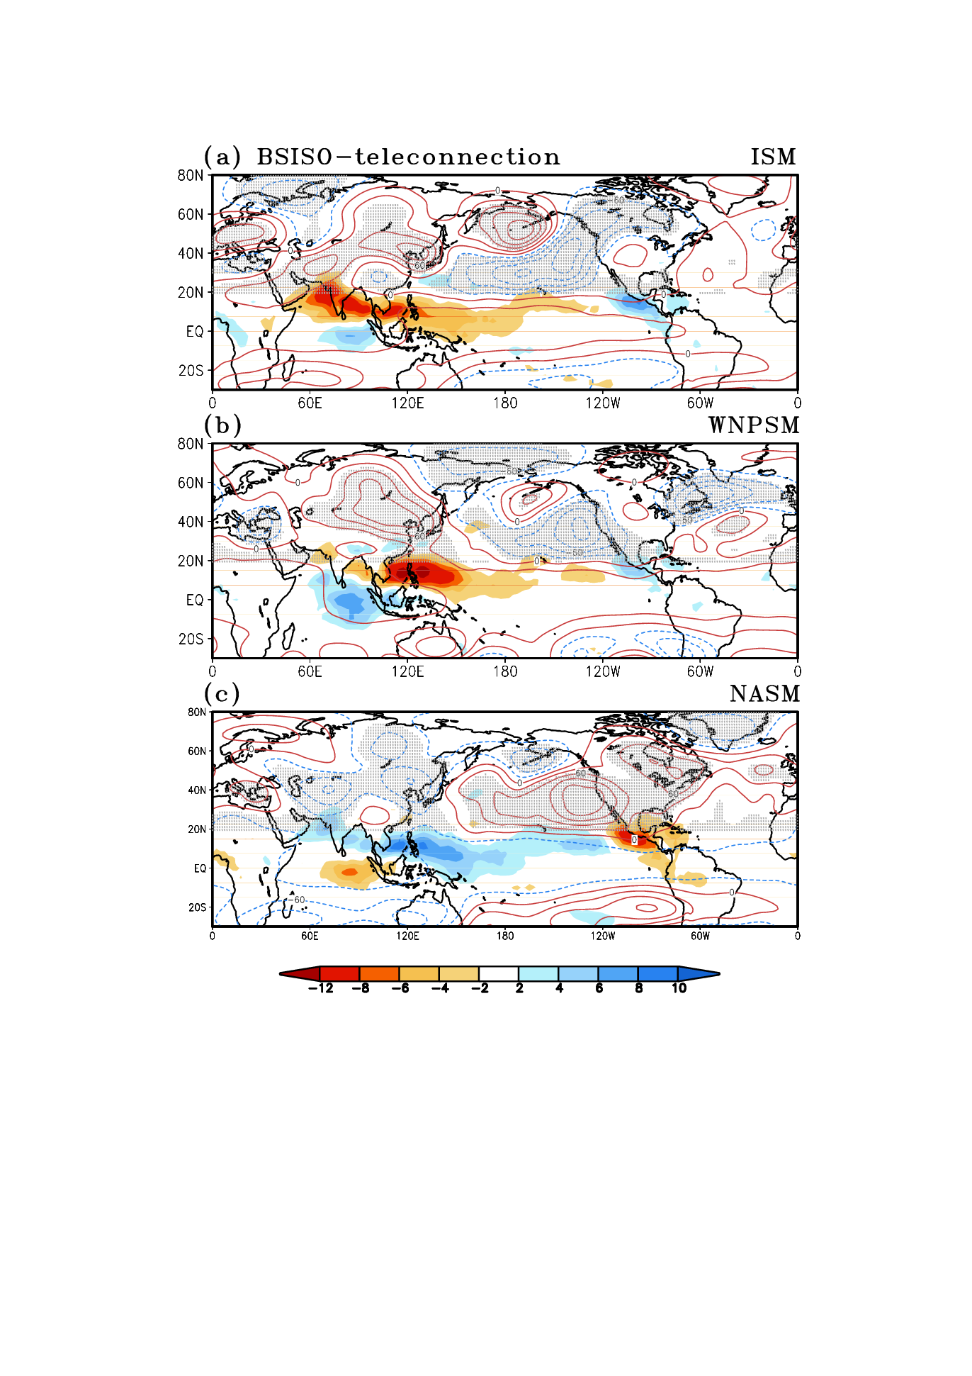
BSISO-teleconnection
L
H
H
H
H
L
H
L
L
L
H
L
H
H
L
L
H
JJAS seasonal mean U200 GPH200 intraseasonal anomaly
Monsoon et al. 2013
OLR intraseasonal anomaly (convective, wet)
OLR intraseasonal anomaly (suppressed, dry)

Slide 46
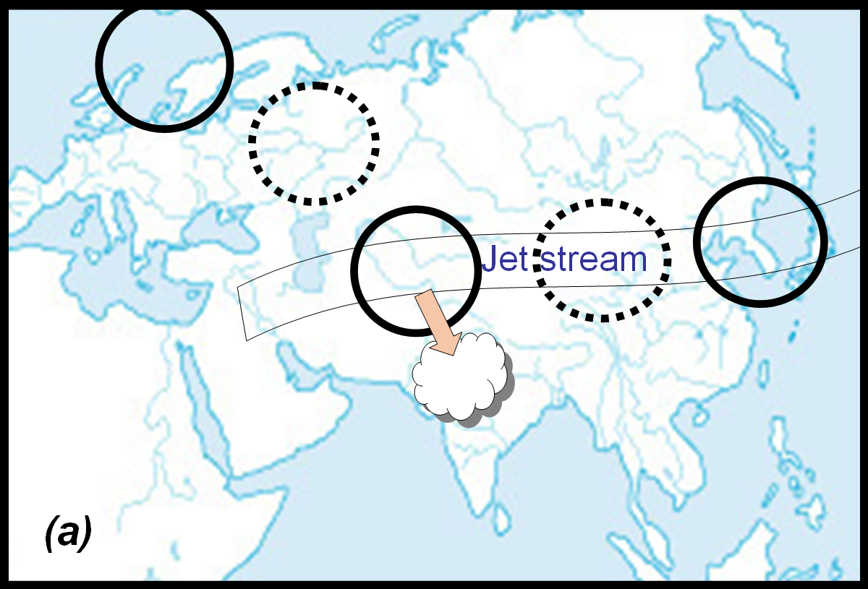
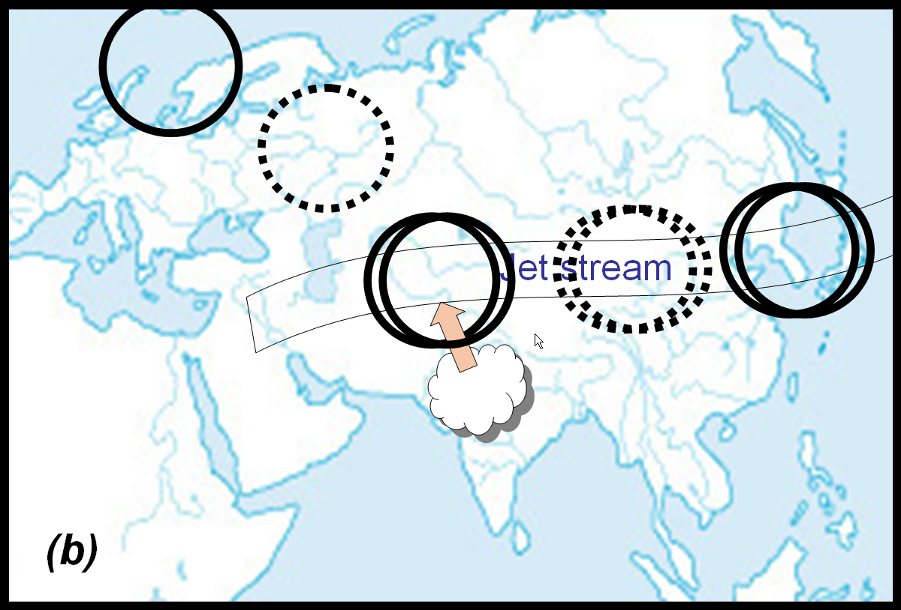
Intraseasonal tropical-extratropical interaction
Barotropic instability
The Eurasian wave train induces anomalous central Asian high, increasing easterly vertical shear over ISM region that destabilizes equatorial Rossby wave and ncreasing monsoon precipitation (Wang and Xie 1996, Xie and Wang 1996).
The northeastern Atlantic anomalous high is presumably excited by efficient kinetic energy extraction from the basic state (Simmons et al 1983).
Vertical shear effect
Rossby wave dispersion
Along jet wave guide
The ISM convection in turn excite a Rossby-wave response to reinforce the central Asian high and a downstream wave train through Rossby wave dispersion.
The baroclinic structure of adjacent circulation associated with the ISM convection indicates the diabatic heating effect of the ISM.
“Monsoon-desert” mechanism
Ding and Wang 2007

Slide 47
5. 30-60 day BSISO diversity
Chen, G., and B. Wang, 2021: Diversity of the Boreal Summer Intraseasonal Oscillation. JGR: Atmospheres, 126, e2020JD034137.

Slide 48
BSISO clusters
K-mean cluster analysis reveals three types of 30-60 day BSISO
NE-ward (BSISO1/2) 2.N-ward Dipole 3. Eastward Expansion
Northward propagation features strong Rossby wave component
Eastward propagation features a strong Kelvin wave easterly.
Point one:
Structural differences causes propagation diversity.

Slide 49
Question: what causes the structural differences?
Unlike boreal winter MJO, the BSISO groups are not related to the ENSO variation
Hypothesis: seasonal variation -> background mean states -> structural differences

Slide 50
How background states affects Rossby wave component?
Enhanced background easterly vertical wind shear -> enhanced barotropic vorticity -> enhanced Rossby-wave winds
Background easterly vertical wind shear

Slide 51
Enhanced background moisture content over BoB -> enhanced horizontal moisture advection by Rossby-wave winds, favoring northward propagation.
Strong meridional asymmetry in moisture content disfavor the development of Kelvin-wave component -> explains why there is no eastward propagation in northward dipole cluster
Background low-level moisture content

Slide 52
Summary
Three archetypes of BSISO: the northeastward propagating (canonical) mode, the northward propagating seesaw dipole mode and the eastward expansion mode.
Each BSISO mode shows distinct circulation structure. A strong Rossby wave response leads to northward. A strong Kelvin wave response leads to eastward propagation
The diverse circulation structures are affected by the variation of the background state, explained by distinct seasonal dependences associated with different BSISO modes.
These results also potentially provide precursors for foreseeing BSISO propagation.

Slide 53
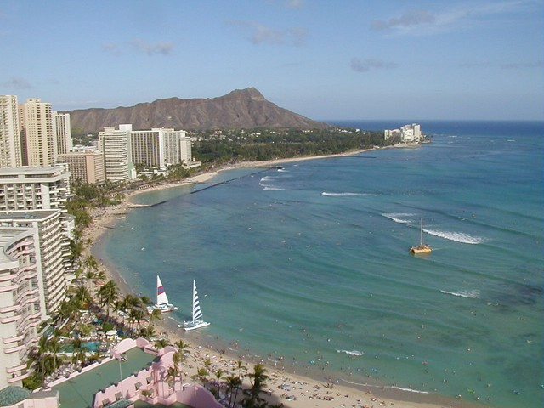
Thank You!
Notes:
53

