Slide 1
Current and Prospective Operational S2S Products from WMO GPCs-LRF, GPCs-SSF and WMO RCCs Arun Kumar Climate Prediction Center, NOAA, USA Chair: WMO Expert Team on Operational Climate Prediction Systems (ET-OCPS) arun.kumar@noaa.gov

Slide 2
Outline
Background on S2S products.
Data sources for developing S2S products.
Current examples of S2S products.
Prospects for S2S products.

Slide 3
Outline
Background on S2S products.
Data sources for developing S2S products.
Current examples of S2S products.
Prospects for S2S products.

Slide 4
Background on S2S products
Most S2S products are based on model-based dynamical forecasts.
General characteristics of S2S dynamical forecast systems:
Outlooks are based on ensemble of forecasts.
There are multiple forecast systems from various operational centers.
Seasonal forecasts – 14 Global producing centers.
Sub-seasonal forecasts – 12 centers participate in S2S Project.
For each forecast system, there is an associated set of hindcasts. The purpose of hindcasts is for:
Bias correction and calibration of real-time forecasts.
Skill assessment of the forecast system.

Slide 5
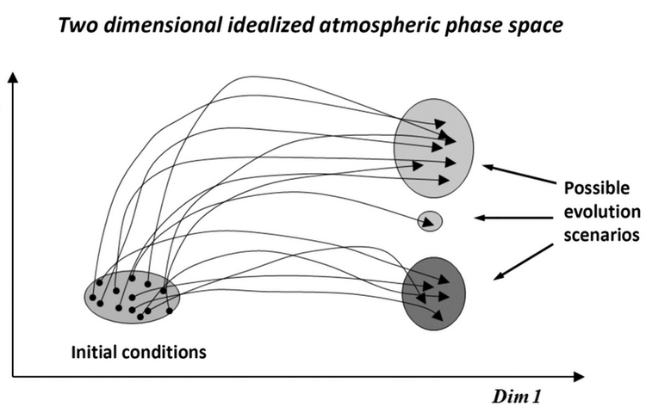
Background on S2S products
Ensemble forecasting: Multiple forecasts start from small differences in initial condition. Their future evolution gives information about various possible outcomes.
In real-time, ensemble size can vary between 10-50.
Ensemble prediction system

Slide 6
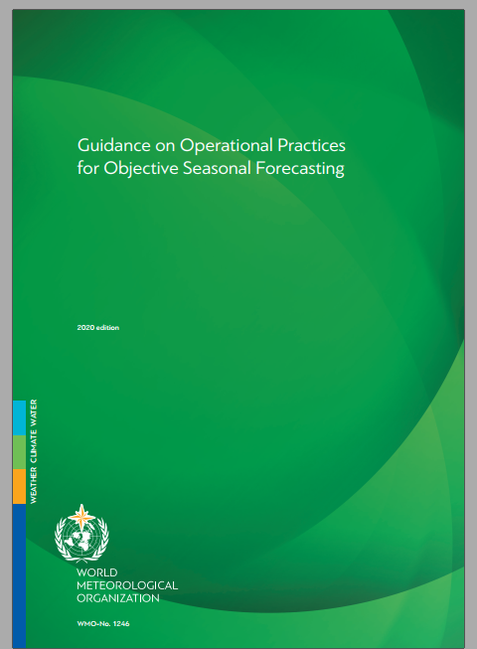
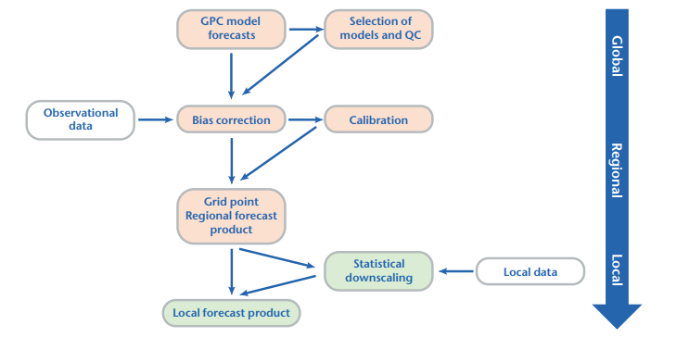
Background on S2S products
Availability of ensembles allows to cast S2S products in probabilistic format.
To reduce the possible influence of biases in a model, multi-model ensemble approach is recommended.
It is important to convey the probabilistic aspect of forecast to the users. This is not a trivial exercise.
WMO is coordinating development of good practices for producing and communicating S2S products.
“Guidance on Operational Practices for Objective Seasonal Forecasting”

Slide 7
Probabilistic forecast format
NMME probabilistic forecast.
One approach is to count ensemble members in below or above normal category.

Slide 8
Probabilistic forecast format
Seasonal outlook for surface temperature. (Source: CPC)
Notes:
-

Slide 9
Outline
Background on S2S products.
Data sources for developing S2S products.
Current examples of S2S products.
Prospects for S2S products.

Slide 10
Data sources: Seasonal
WMO Lead Center for Long-Range Forecasts Multi-Model Ensemble (LC-LRFMME) (https://wmolc.org/
North American Multi-model Ensemble (NMME)
Copernicus Climate Change Service (C3S) seasonal forecasts.
Individual operational centers.
For research purposes, seasonal hindcast data can be obtained from sources – IRI.

Slide 11
Data sources – Sub-seasonal
SubX Project – IRI
S2S Project: Currently, not available in real-time. Once the WMO infrastructure for sub-seasonal forecast is in place, data should be available from the (future) Lead Center for Sub-Seasonal Forecast Multi-Model Ensemble (LC-SSFMME).
Delayed mode data available from ECMWF, CMA and IRI.
Individual operational centers.

Slide 12
Outline
Background on S2S products.
Data sources for developing S2S products.
Examples of S2S products.
Prospects for S2S products.

Slide 13
Examples of products: Seasonal
Spatial maps
Surface temperature, rainfall, selected circulation fields.
Deterministic (average seasonal mean anomaly).
Probabilistic (probability of seasonal mean anomaly to be in below-, normal-, or above-normal category).
Indices
Various Niño indices, Indian Ocean dipole etc. (evolution of mean anomaly over the forecast period).
Deterministic.
Forecast plumes (evolution of indices in individual forecasts).

Slide 14
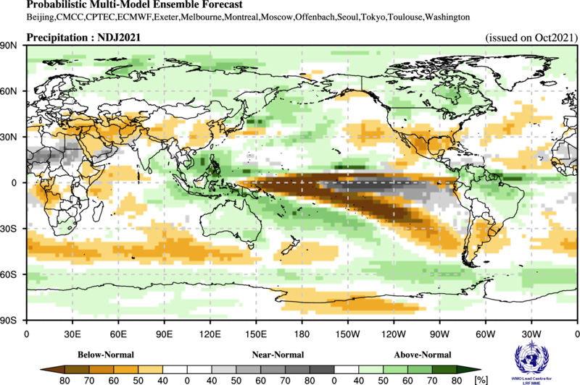
Probabilistic seasonal outlook for rainfall to be in different categories (WMO LC)

Slide 15
Probabilistic seasonal outlook for surface temperature to be in different categories – C3S

Slide 16
Probability of seasonal mean temperature to be above a certain climatological threshold – C3S

Slide 17
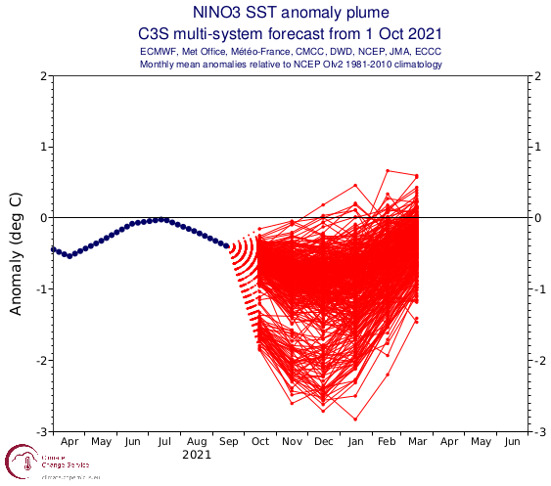
Evolution of Niño3.4 SST index – NMME, C3S

Slide 18
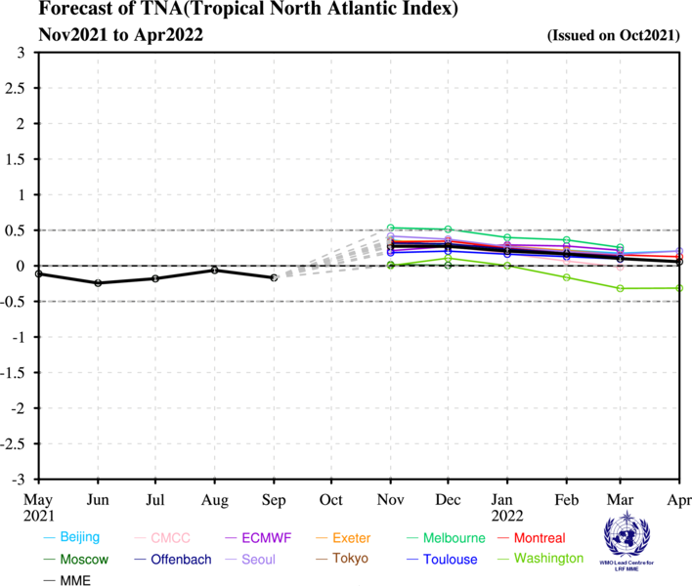
Evolution of Niño3.4 SST index – Indian Ocean Dipole, Tropical North Atlantic Index

Slide 19
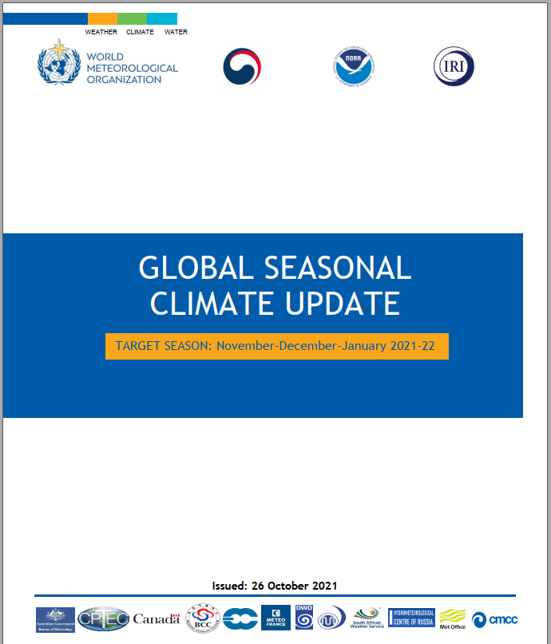
Global Seasonal Climate Update (GSCU)
Released every month.
GSCU provides a summary of observed anomalies for the previous season.
Includes outlook for the next season
Surface temperature.
Rainfall
Indices (e.g., ENSO)

Slide 20
Examples of products: Subseasonal
Spatial maps
Surface temperature, rainfall, OLR, zonal wind anomaly, extreme forecast index (EFI).
Deterministic (average seasonal mean anomaly).
Probabilistic (probability of seasonal mean anomaly to be in below-, normal-, or above-normal category).
Indices
Madden Julian Oscillation (MJO), North Atlantic Oscillation (NAO), Blocking , sudden stratospheric warming (SSW) .
Deterministic (evolution of mean anomaly over the forecast period).
Forecast plumes (evolution of indices in individual forecasts).

Slide 21
Day 5-11 Surface Temperature – C3S

Slide 22
Extreme Forecast Index (EFI)

Slide 23
MJO Prediction

Slide 24
PNA Index Prediction

Slide 25
Outline
Background on S2S products.
Data sources for developing S2S products.
Examples of S2S products.
Prospects for S2S products.

Slide 26
Prospects for S2S Products
As S2S real-time forecast data becomes widely available, their utilization and scope of products will increase.
Possible examples of future products:
Probabilistic forecast of consecutive days with temperature above a certain threshold (e.g., heat waves) within the forecast period.
Outlooks for quantities with user defined thresholds.
Outlooks with joint probabilities – dry and hot; cold and snowy days.
Enhancement of Interactive capabilities.

Slide 27
Prospects for S2S Products
Outlooks tailored for specific region of phenomenon. Examples
Monsoon start and withdrawal date.
Tropical storms.
Spector specific outlooks
Humanitarian (Disaster risk reduction),
Public health.
Energy.
Agriculture.
Water management.
Impact based forecasts.

Slide 28
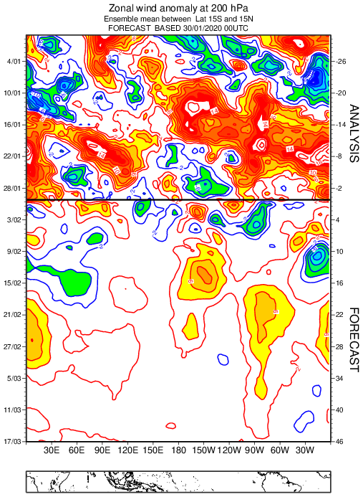
Thanks!

